Slide 1

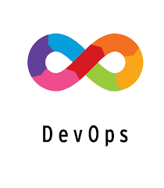
AWS DevOps INTERNSHIP
MAIN PROJECT – 1
BY MUJAHID SHAIK

Slide 2


DEPLOYING 3 TIER
ARCHITECTURE IN AWS USING TERRAFORM

Slide 3
INTRODUCTION
This guide is about deploying a 3-tier architecture on Amazon Web Services (AWS) using Terraform. In simple terms, it helps you set up a structure where your application is divided into three layers: one for what users see, one for the logic behind the scenes, and one for storing data.
The goal is to make this process easy to understand the architecture and working of the 3-tier web application.
TERRAFORM is an open-source Infrastructure as Code (IaaC) tool developed by HashiCorp. It allows users to define and provision infrastructure in a declarative configuration language. With Terraform, you can manage and automate the creation, modification, and versioning of infrastructure resources across various cloud providers, on-premises environments, and even third-party services.

Slide 4
MAIN USES OF TERRAFORM
INFRASTRUCTURE PROVISIONING streamlines the creation of computing resources, networks, and services, ensuring rapid and consistent deployment to support application needs.
MULTI-CLOUD MANAGEMENT involves orchestrating and overseeing resources across different cloud providers, enabling flexibility, redundancy, and optimization in a diverse cloud environment.
Terraform treats INFRASTRUCTURE AS CODE, providing a version-controlled and collaborative approach to managing and evolving the infrastructure, enhancing collaboration and traceability.
Terraform enables the AUTOMATIC PROVISIONING and management of infrastructure, reducing manual intervention and ensuring efficient resource deployment.

Slide 5
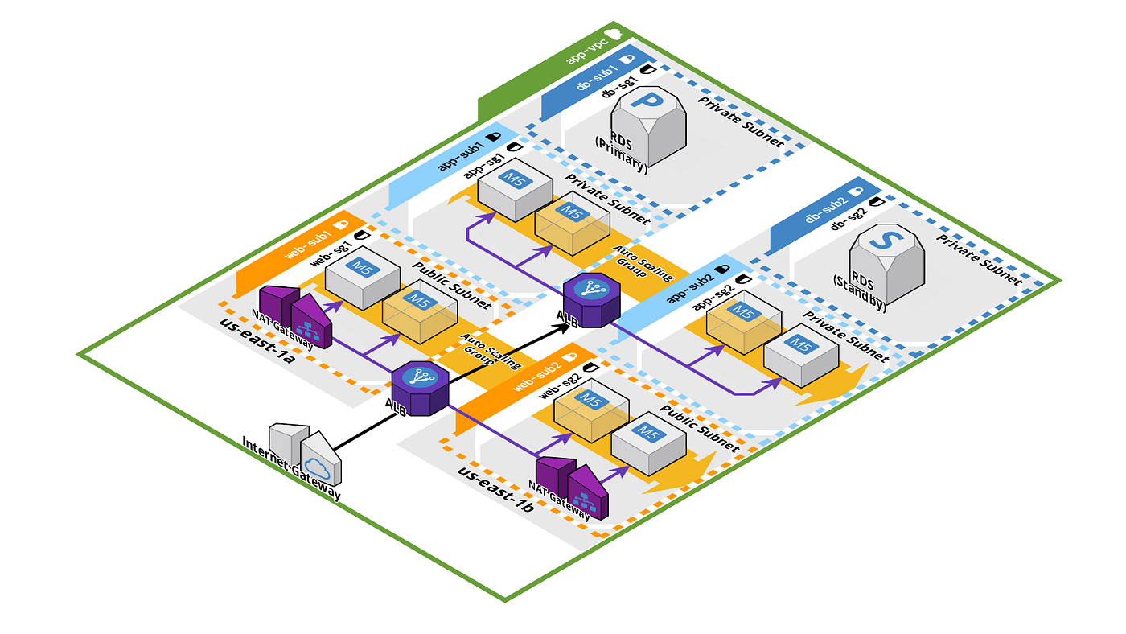
PROJECT ARCHITECTURE
This project follows the classic 3-tier architecture, consisting of the Presentation Layer, Application Layer, and Database Layer.
Each layer is designed to be scalable and fault-tolerant.
The Presentation layer,
The Application layer and
The Database layers.

Slide 6
ARCHITECTURE COMPONENTS
The PRESENTATION LAYER often known as the front end, focuses on user interface and user experience. It involves designing and rendering the graphical elements that users interact with, encompassing everything from web pages to graphical user interfaces (GUIs) in applications.
The APPLICATION LAYER is situated between the presentation and database layers, serves as the core processing unit of a software application. It manages business logic, processing user requests, and orchestrating data flow between
the presentation and database layers.
The DATABASE LAYER, located at the backend, is responsible for storing, managing, and retrieving data in a structured manner. It acts as a repository for the application's data, providing a reliable and efficient means of data storage.
The database layer plays a crucial role in supporting the application's functionality by ensuring data integrity, security, and facilitating seamless data access and manipulation.

Slide 7
USE OF 3 TIER ARCHITECTURE
SCALABILITY with Terraform means you can easily make your computer system bigger or smaller based on how much work it has to do. So, if more people start using your application, you can quickly add more resources to handle the load. Terraform makes this easy by letting you manage and adjust these resources in a simple and organized way.
FLEXIBILITY with Terraform means you can quickly and easily change your computer system as your needs change. Whether it's adding new features, adjusting configurations, or switching to a different cloud service, Terraform lets you make these changes smoothly by using simple code.
The separation of concerns between tiers enhances SECURITY by limiting direct access to sensitive data.

Slide 8
TECHNOLOGIES USED :
Terraform: Infrastructure as Code (IaaC) tool for provisioning and managing AWS resources.
AWS Services: Utilizing services such as EC2, VPC, RDS, ELB, AS, etc.
PRE-REQUISITES :
AWS Account Setup: Create and configure an AWS account to access AWS services.
Tool Installation: Install the AWS CLI and Terraform on your local machine.
IAM User and Permissions: Set up an IAM user with appropriate permissions for Terraform.
Networking Plan: Plan the VPC, subnets, and security groups for your architecture.
Resource Configuration: Determine AMIs, database configurations, SSH key pairs, and prepare Terraform files for EC2 instances, RDS, and other resources.

Slide 9
PROCEDURE
Open your AWS management console and launch an EC2 Instance with Amazon Linux 2 OS, t2.micro type, Allowing Inbound rule port 22 allowed from My IP.
Then open IAM service and create access key and secret key to your user.
Login to your Instance through terminal, and install terraform using the Hashi corp’s official terraform installation link. https://developer.hashicorp.com/terraform/install
Configure in to your AWS account using access key and secret key.
Use command [aws configure] to configure, then provide your access and secret key, then type the region in which you want to create your Infrastructure and then the type of output format. Either JSON or YAML or PLAIN TEXT.
After completion of configuring, create a directory for your project to write the terraform scripts.
Initialize the directory using command [terraform init] to download the necessary provider plugins and initialize the backend.

Slide 10
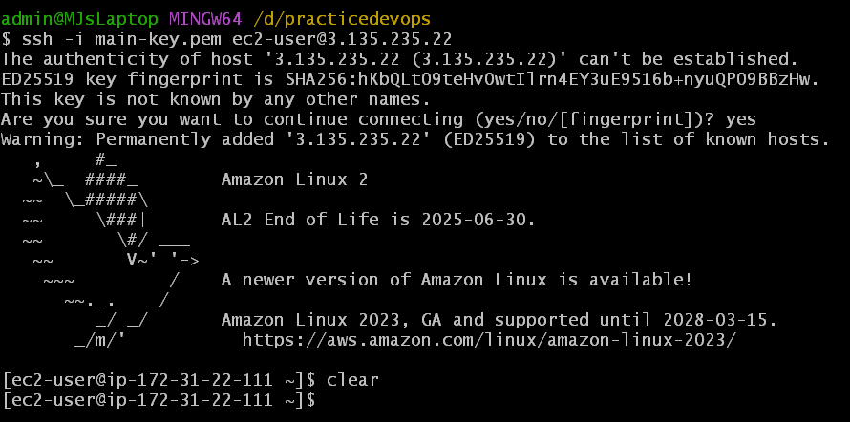
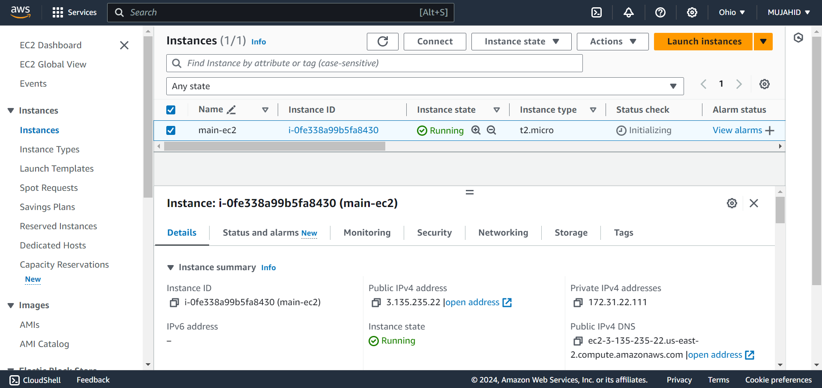
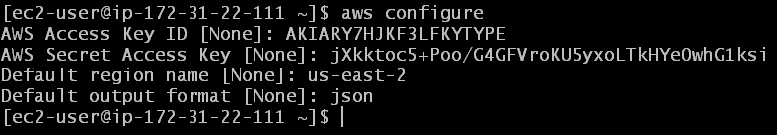
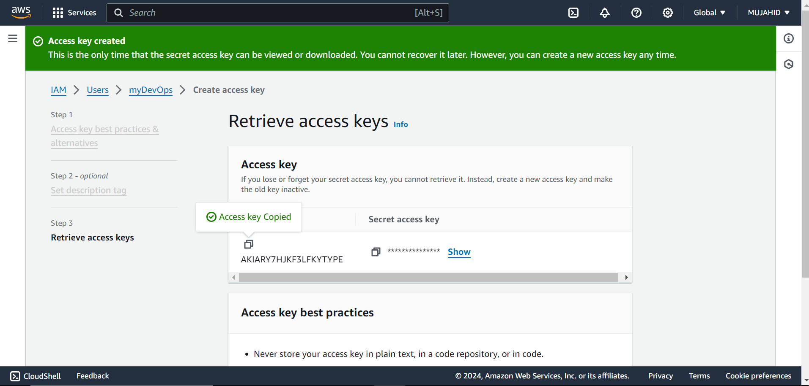
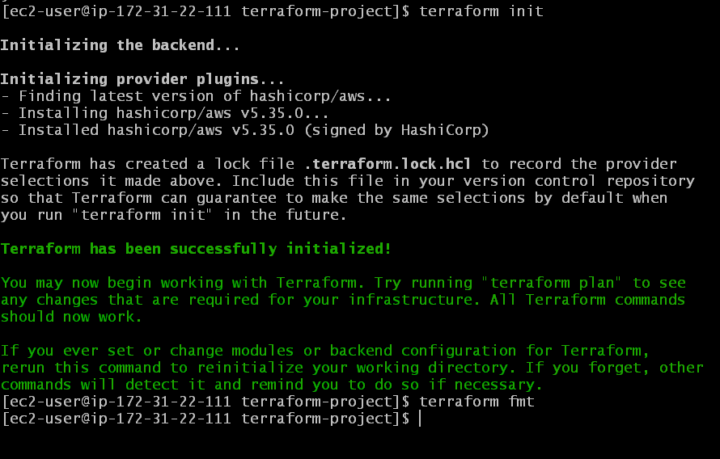

Slide 11
TERRAFORM CONFIGURATION FILES
Start creating files and write scripts to Create Resources in your AWS Account.
Create a file vpc.tf and write the script to create a VPC Network.
Add appropriate CIDR block Variable that matches the its value in the variables.tf file.
Create a file subnets.tf to create subnets for the above VPC.
In our Infrastructure we are creating 6 subnets in which 2 are public subnets which represent the Presentation layer which carries our EC2 Instances.
And then 4 are private subnets in which 2 represent Application layer and 2 represent Database layer.
Give the names of the subnets in a way that you can easily remember and understand.
Add appropriate CIDR block range such that they do not overlap with each other.
Add variables to the to this CIDR blocks and their values.

Slide 12
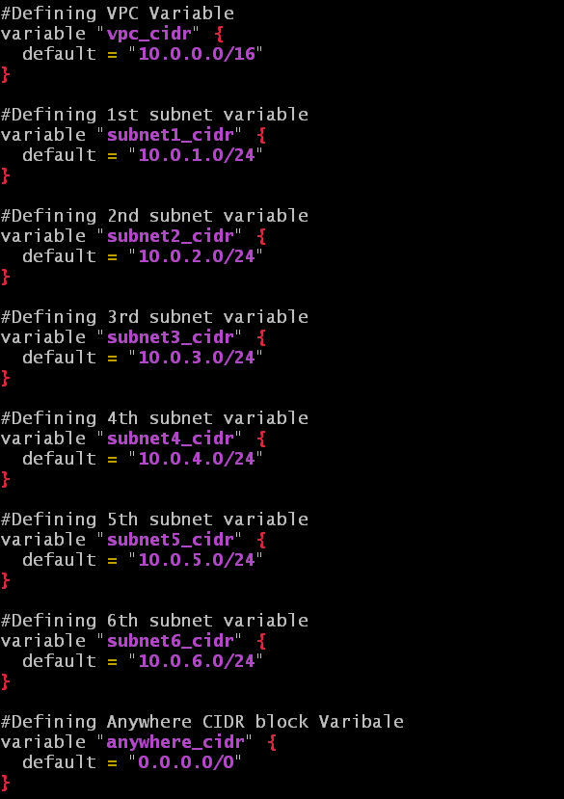
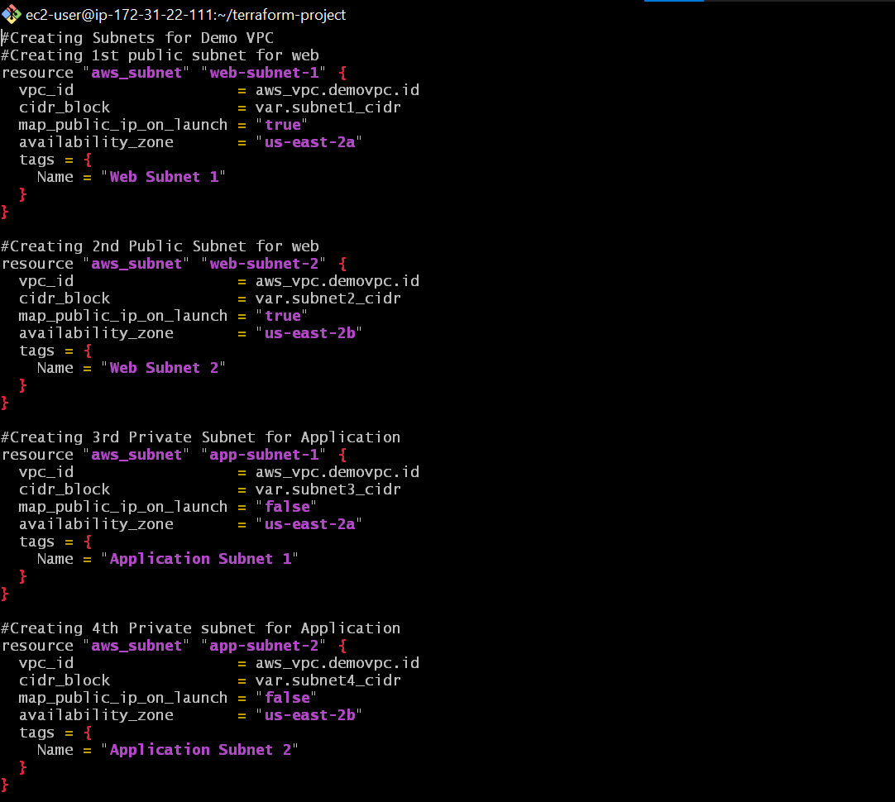
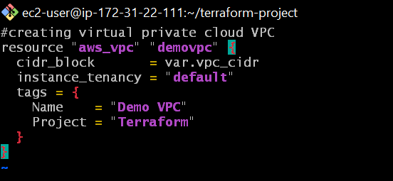
VARIABLES
SUBNETS
VPC

Slide 13
TERRAFORM CONFIGURATION FILES
Create a file igw.tf to create internet gateway and attach it to the VPC that we created earlier.
Create a file routetable.tf to create a route table that routes the public instances to connect to the internet through internet gateway.
Create a file ec2.tf to create 2 Instances, mention all the configurations that we do to create an Instance in AWS management console.
Create a key pair in the instance home directory using command
[ssh-keygen -t rsa -b 2048 -f instance-key]
Mention the VPC and Subnets in which the instances should be placed.
In the user data section mention the files that we will create later which hosts our static web application in the front end tier.
Create keypair.tf file to mention the key and its path through which our instance can be accessed.

Slide 14
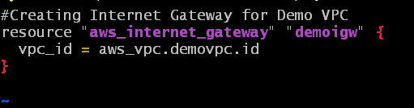
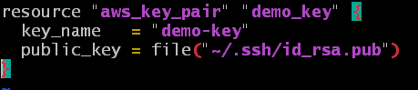
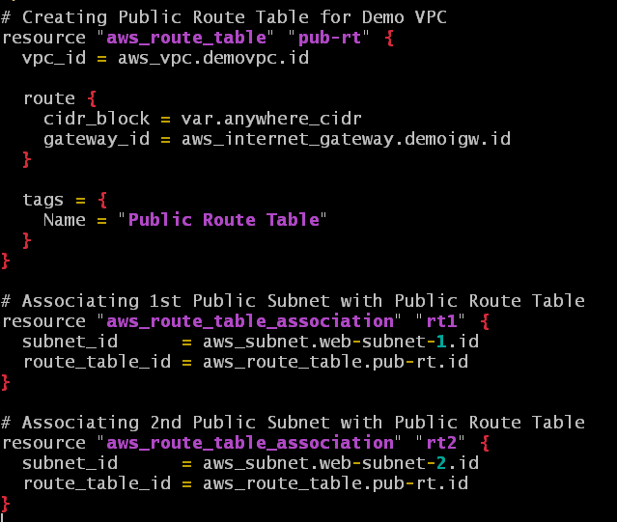
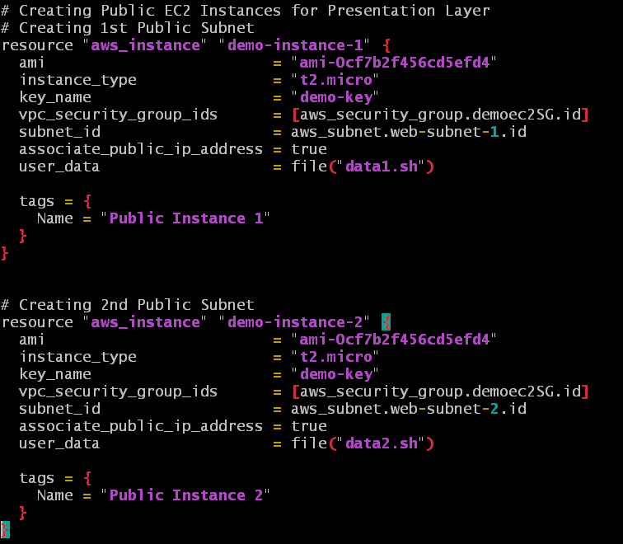
IGW
KEY PAIR
ROUTE TABLE
INSTANCES

Slide 15
TERRAFORM CONFIGURATION FILES
Create files named data1.sh & data2.sh for the 1st and 2nd instances user data.
Write the script for hosting static web application in your instance in bash shell. It is ECOMM application for the 1st Instance & FOOD application for the 2nd Instance.
Create a file ec2-sg.tf to create security group for our EC2 Instance with Inbound Rules allowing Port 22 from My IP, Port 80 from Load Balancers security group which we’ll create later and Port 443 from anywhere.
And Outbound Rules allowing all traffic anywhere.
Create a file elb.tf to create an Application Load Balancer with the following configurations;
Target group, Attaching Instance 1 & 2 to the Target group, Load balancer listener.
Mention depends on attribute so that load balancer is created only after the creation of instances and target group.
Create a Security Group for load balancer with a file named lb-sg.tf allowing port 80 anywhere.

Slide 16
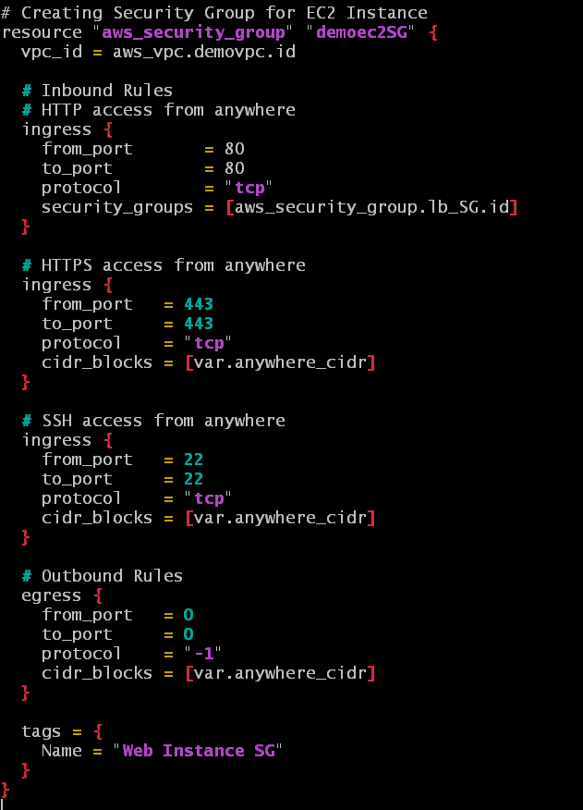
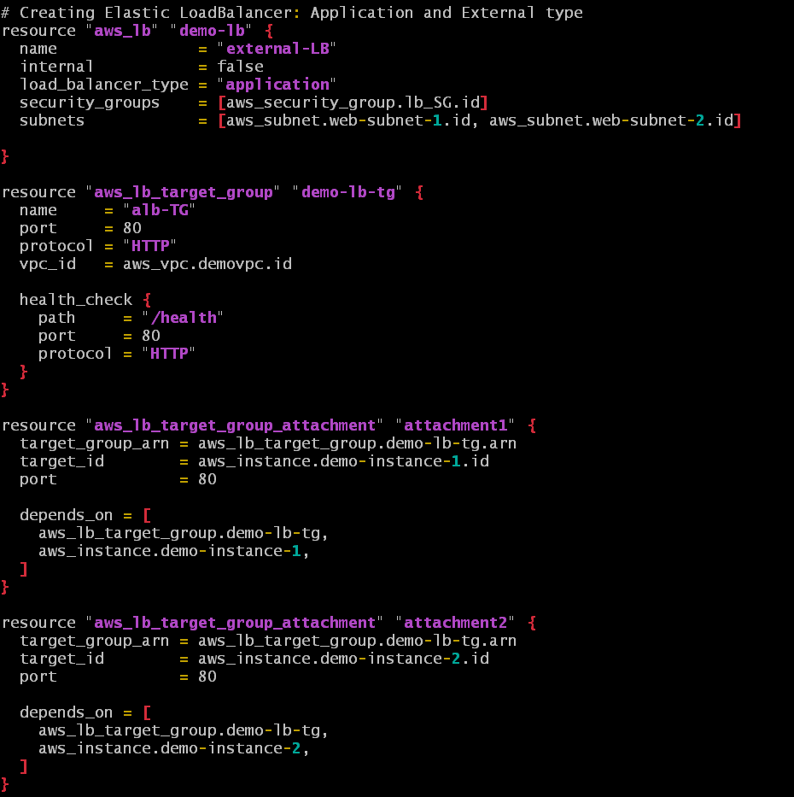
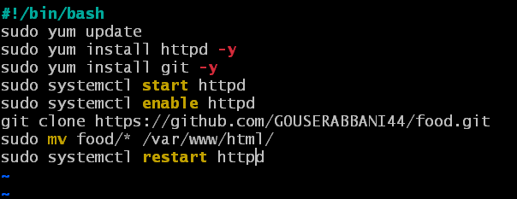
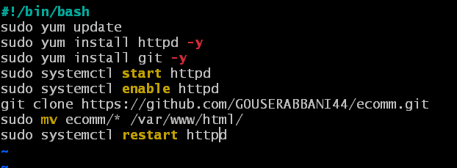
SG FOR INSTANCES
LOAD BALANCER
DATA 1
DATA 2

Slide 17
TERRAFORM CONFIGURATION FILES
Create a file asg.tf to create Auto Scaling Group and Launch configuration
Mention the following attributes ; Creation of launch configuration, auto scaling group, health check that depends on Load Balancer & attaching auto scaling group to load balancer.
Create a file database-sg.tf to create a security group for our Database allowing port 3306 from our Instance Security Group.
Then create a file rds.tf to create a Database and a database Instance with the following attributes; mention the subnets that are created for database, mention the security group that is created for database earlier, allocated storage, Database engine, its version, Instance class, username and password to access the Database later.
Create a file outputs.tf mentioning the output of DNS link of load balancer, Public IP’s of first and second Instances.

Slide 18
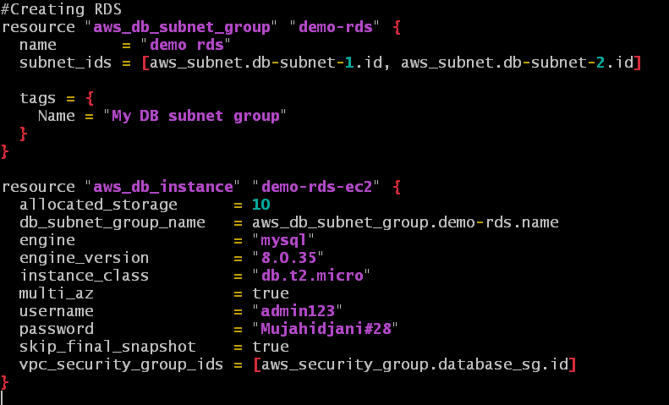
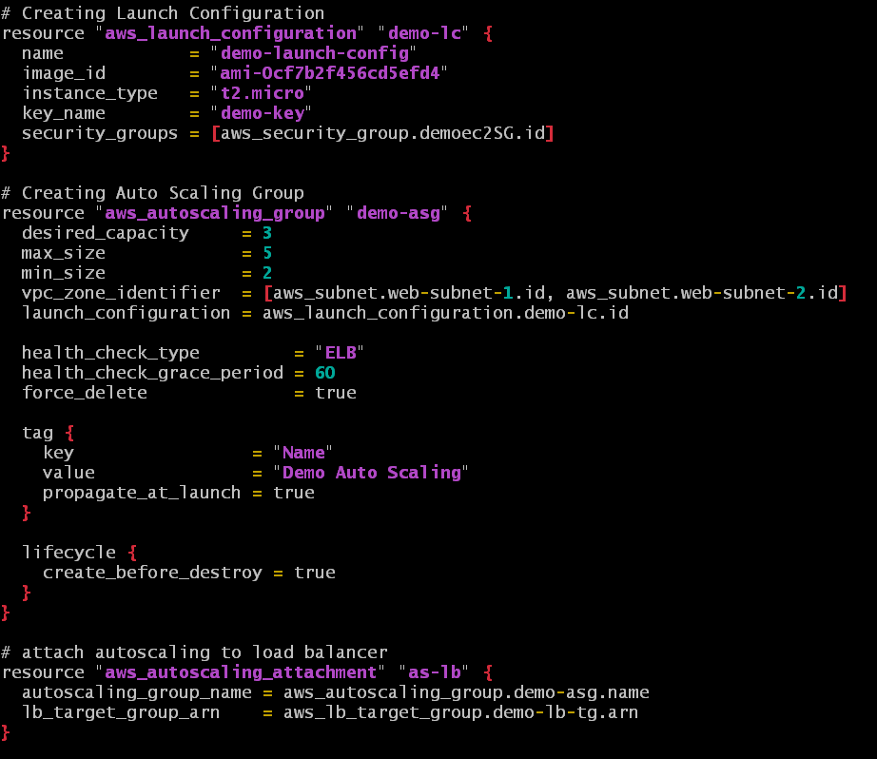
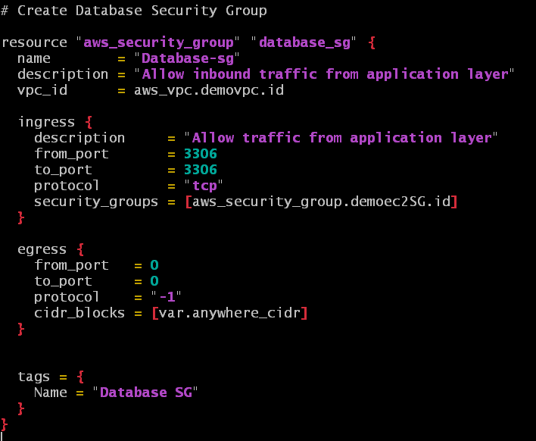
RDS
AUTO SCALING GROUP
DATABASE SECURITY GROUP

Slide 19
DEPLOYMENT PROCESS
After the completion of writing terraform scripts for the creation of infrastructure resources, execute command [terraform fmt] to make the files in canonical format.
Execute command [terraform validate] to encounter any errors present.
Execute command [terraform plan] to generate and preview the execution plan of our infrastructure.
Execute command [terraform apply] to deploy our infrastructure.
Wait for a while and check the resources that’s been created.
Copy the DNS link of the Load Balancer that appears at the end of the deployment and browse it in the browser and we can see our application active and running.

Slide 20
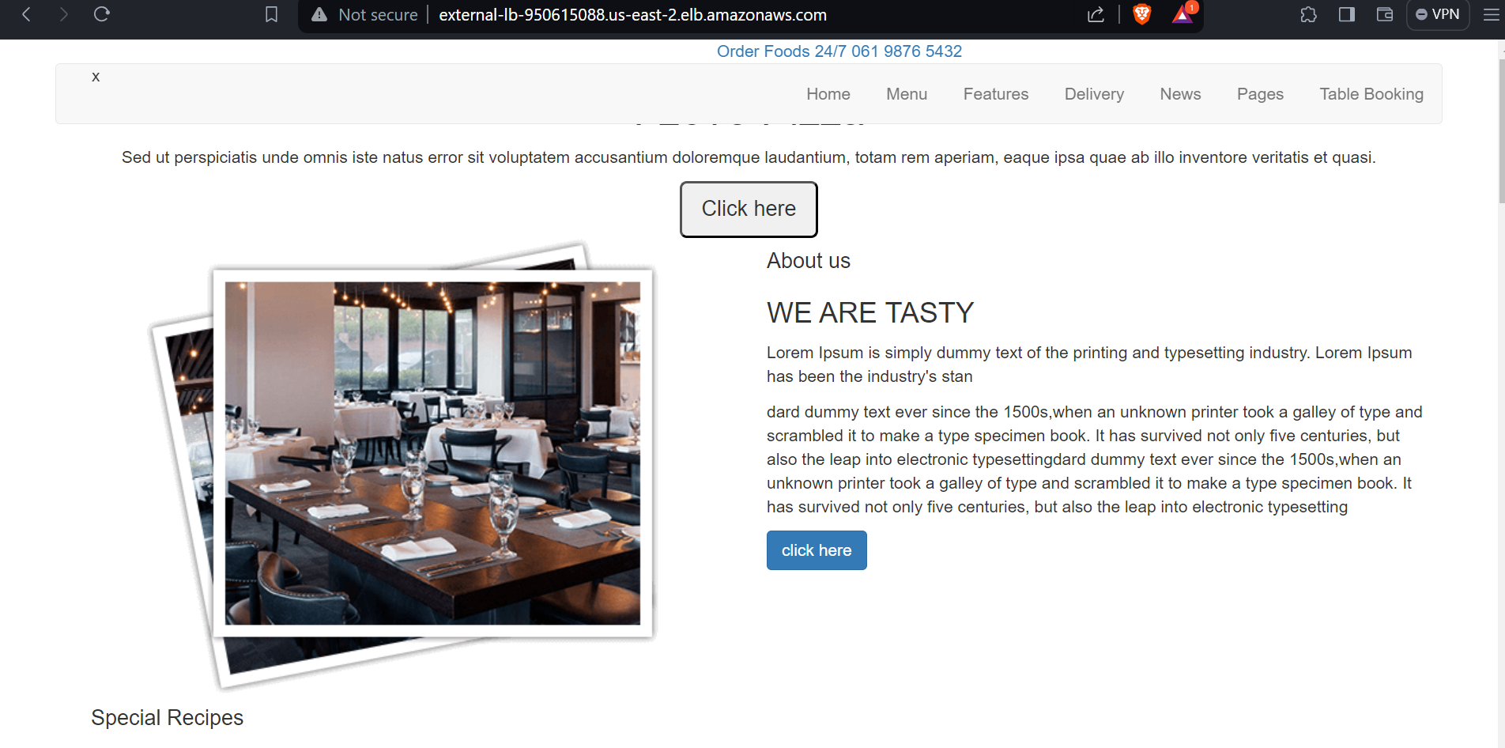
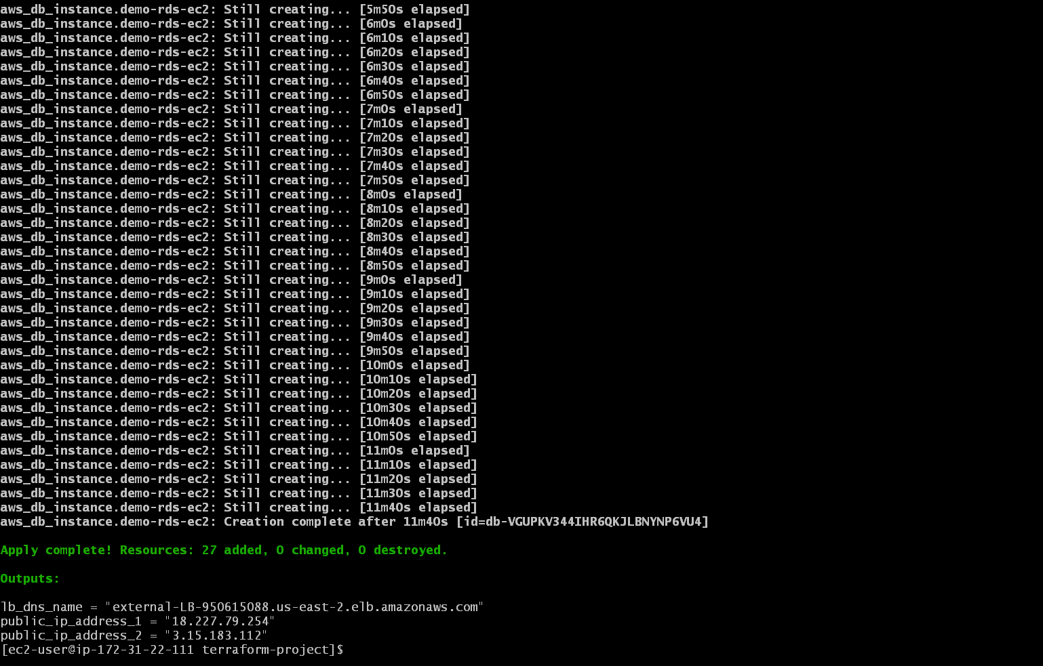
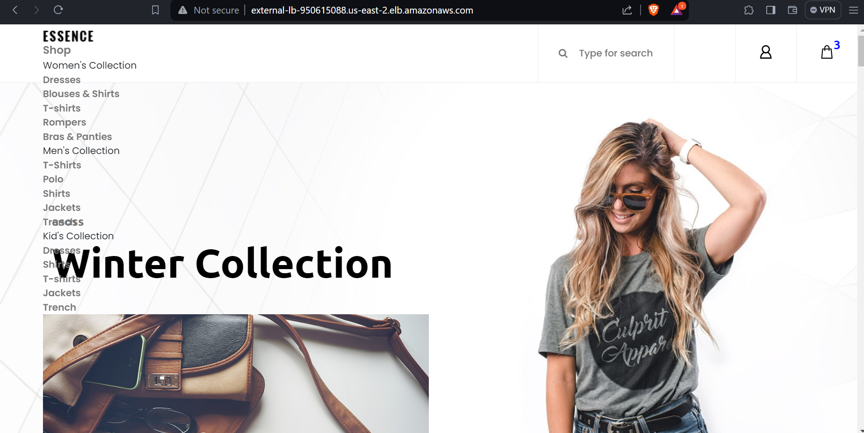

Slide 21
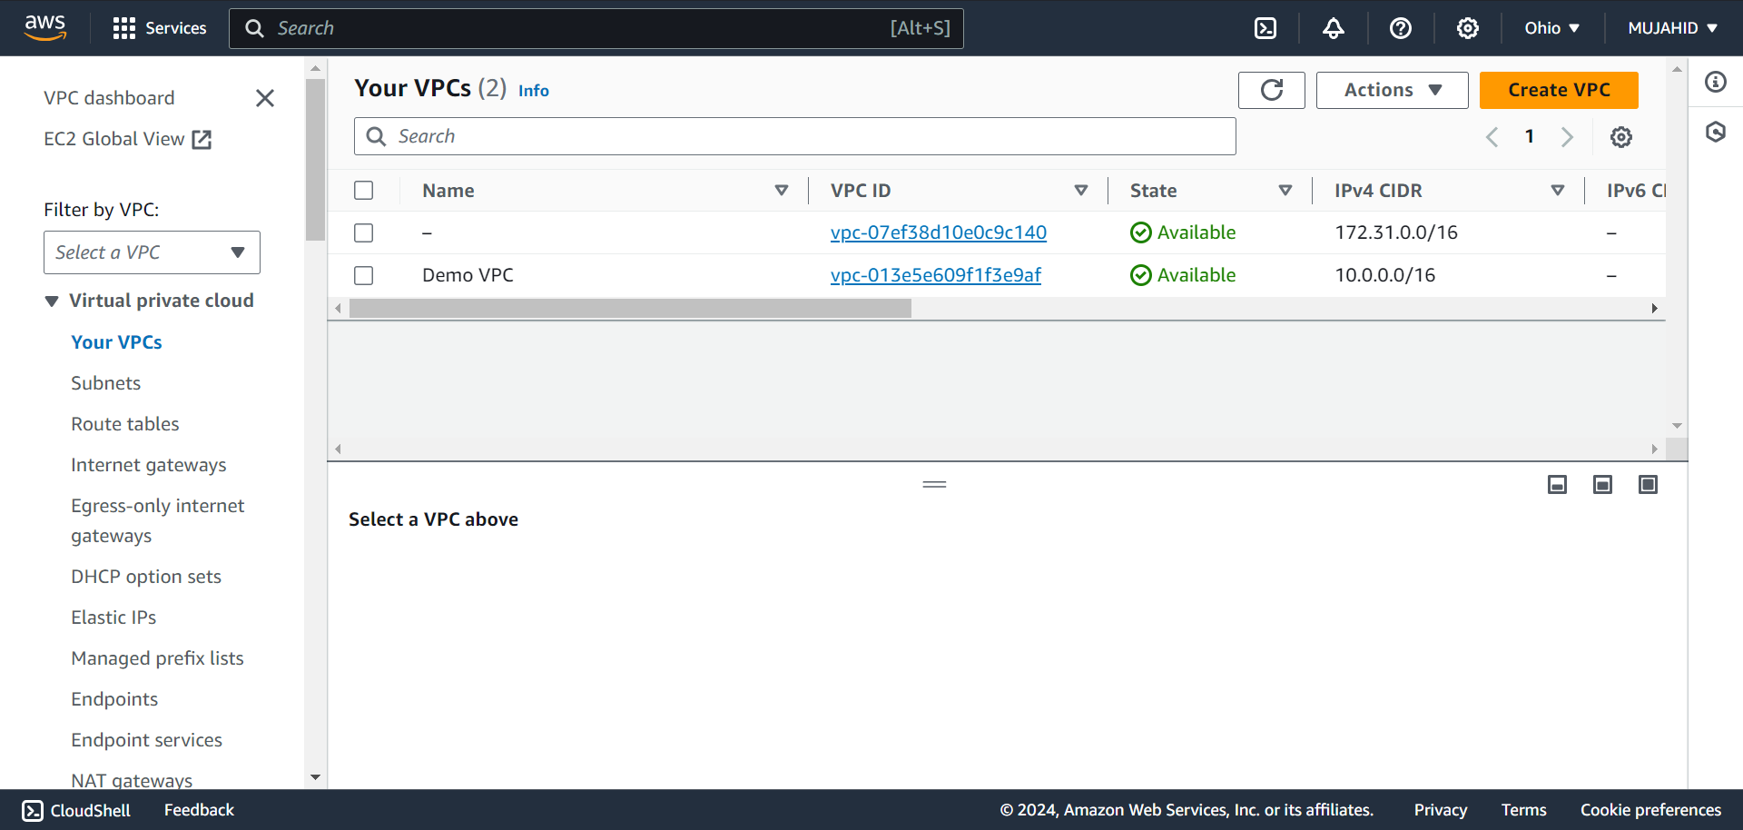
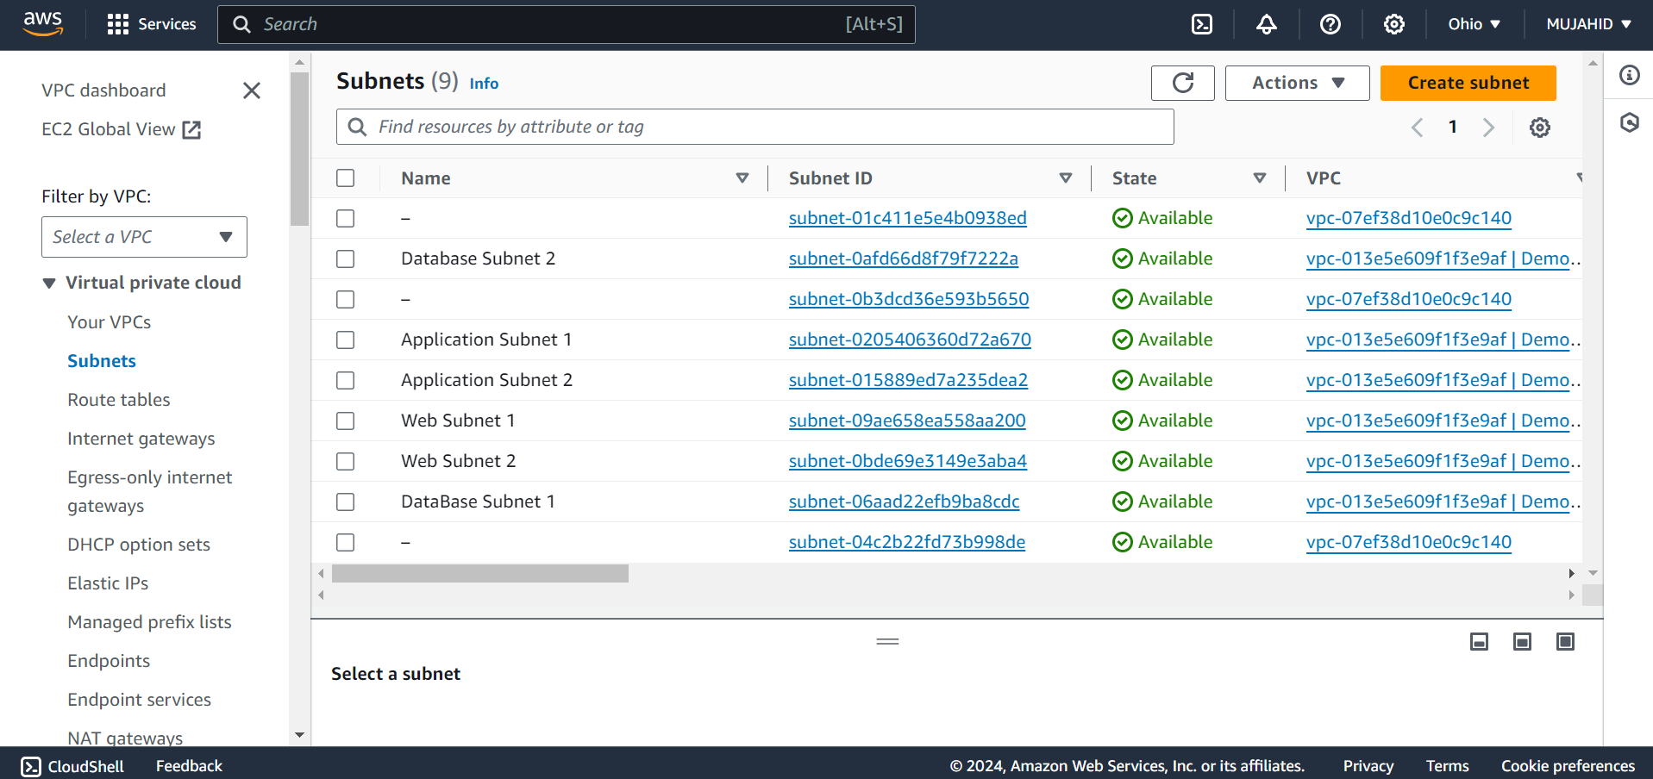
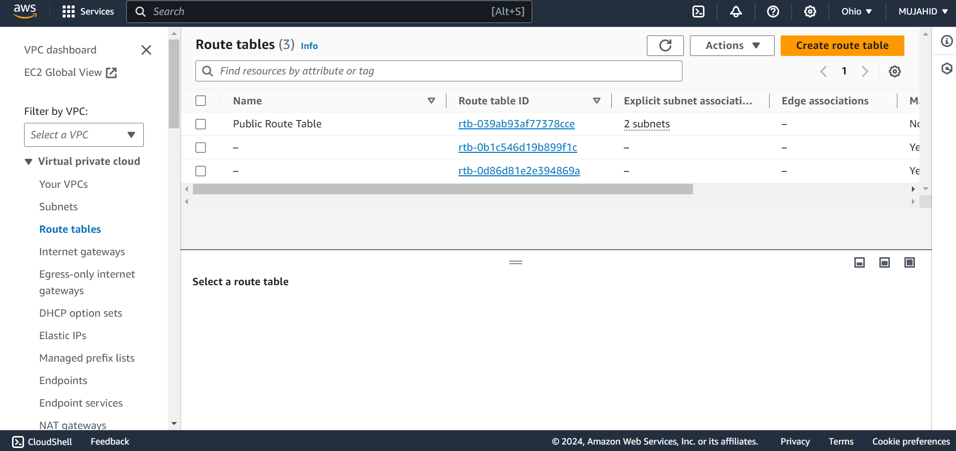
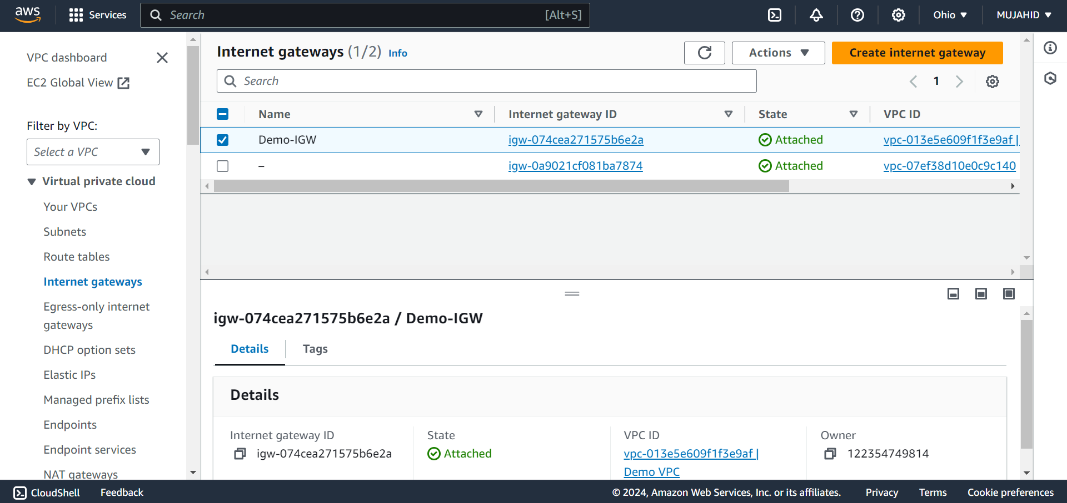
CREATED RESOURCES IN AWS
VPC
SUBNETS
ROUTE TABLES
INTERNET GATEWAY

Slide 22
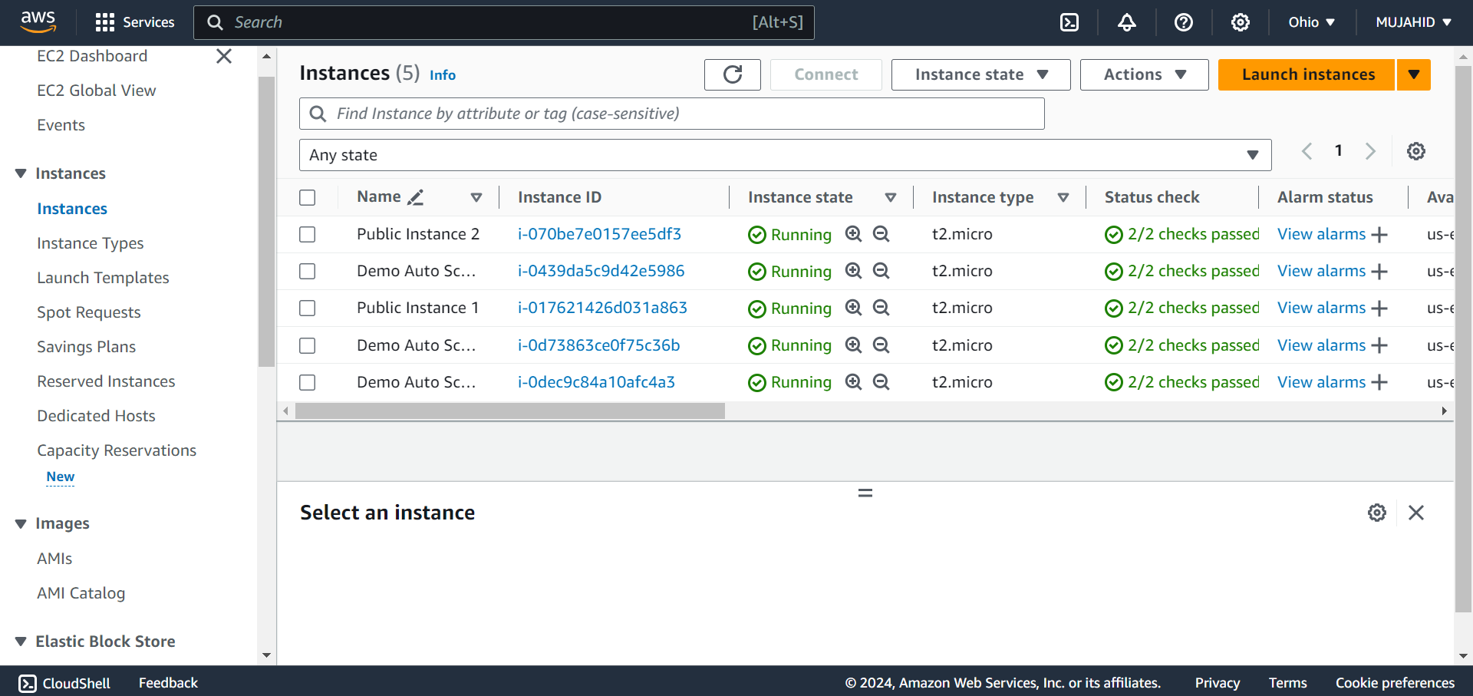
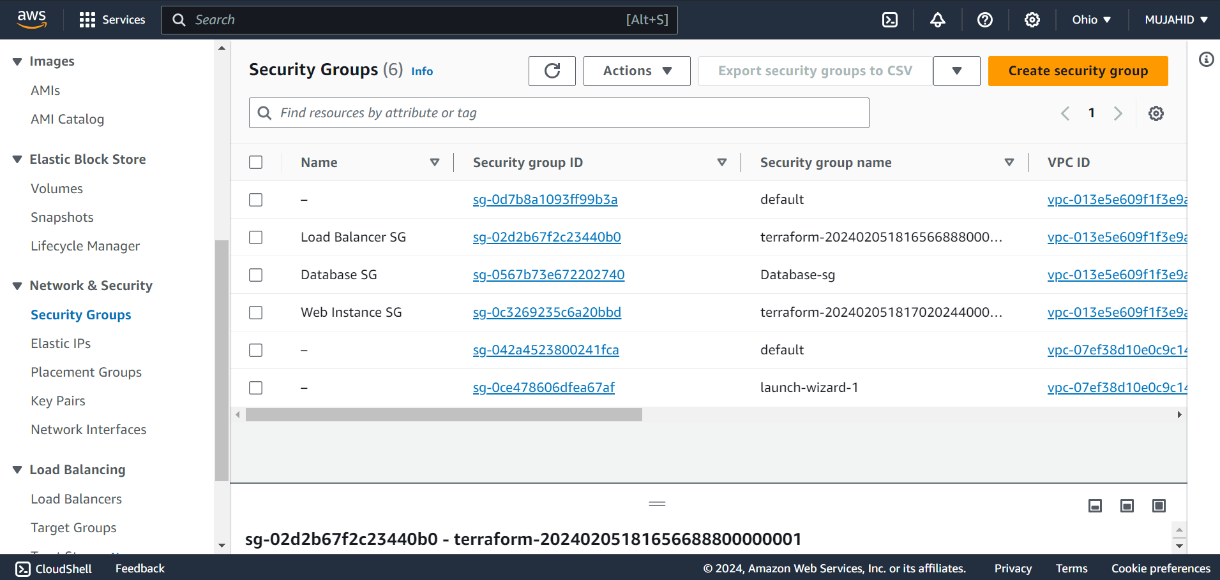
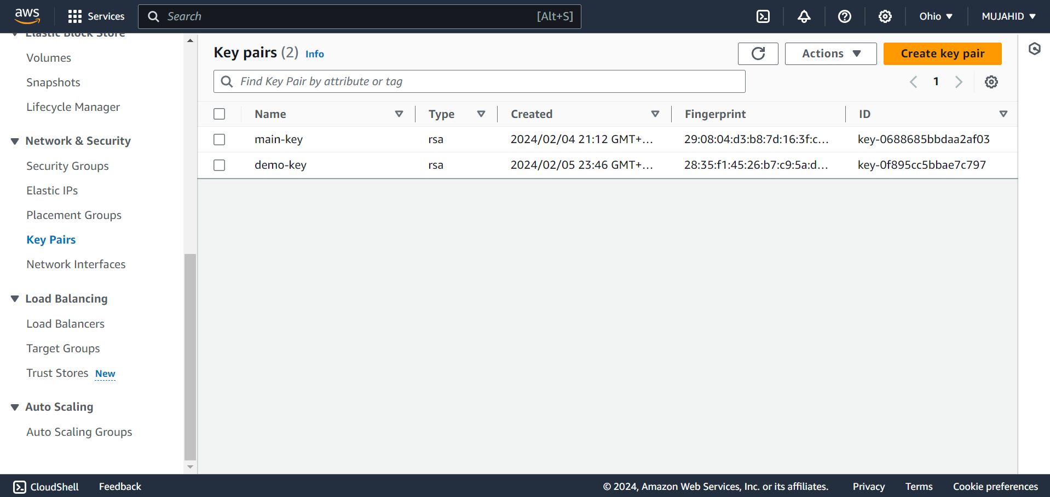
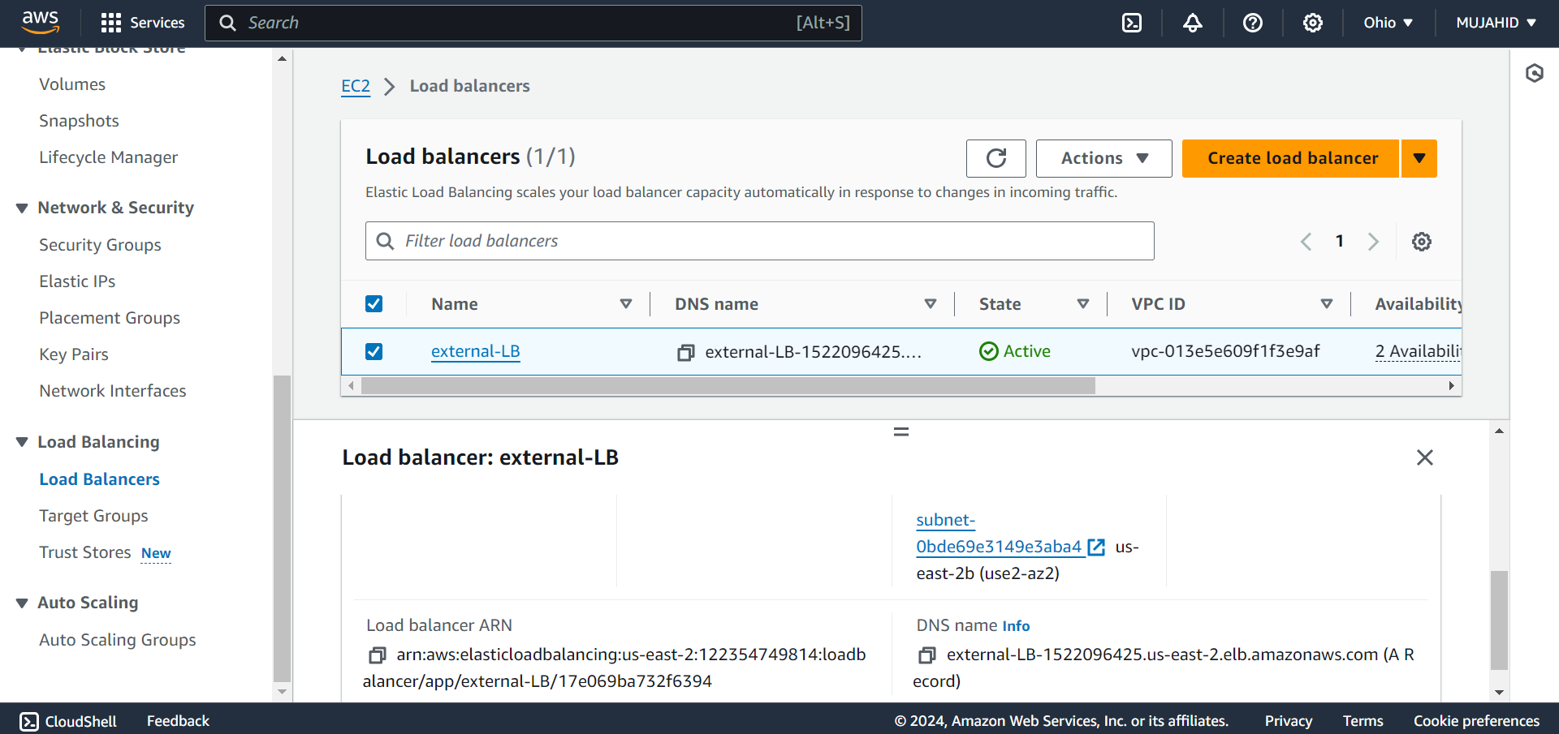
CREATED RESOURCES IN AWS
INSTANCES
SECURITY GROUPS
KEY PAIR
LOAD BALANCER

Slide 23
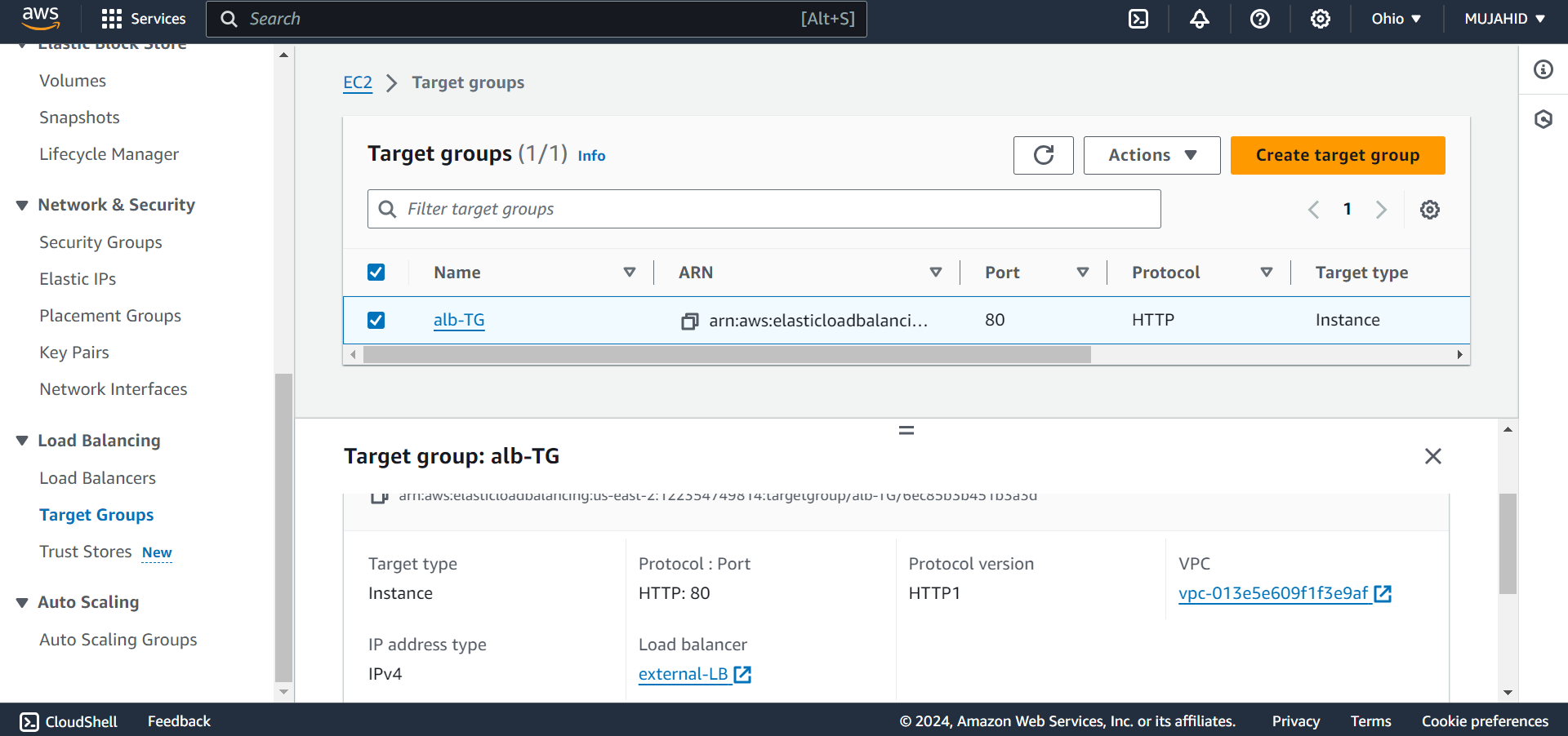
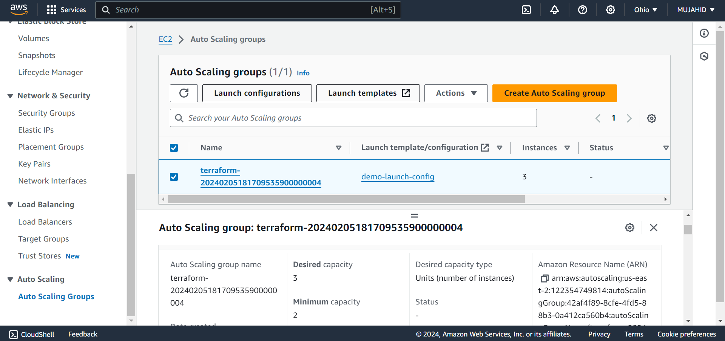
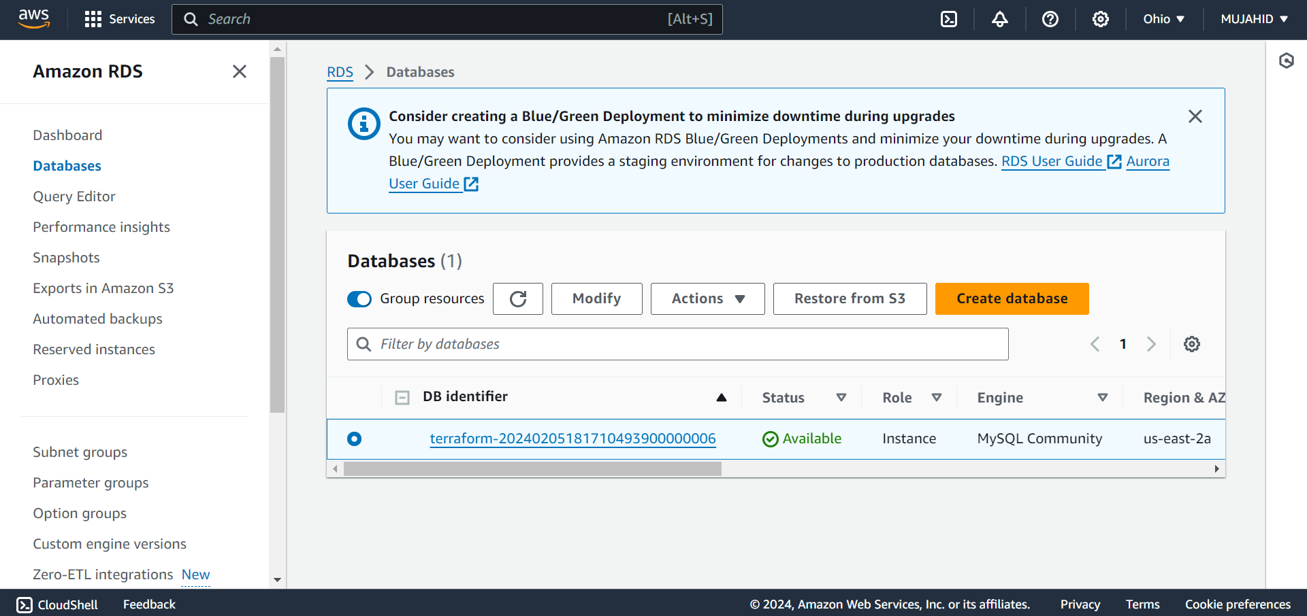
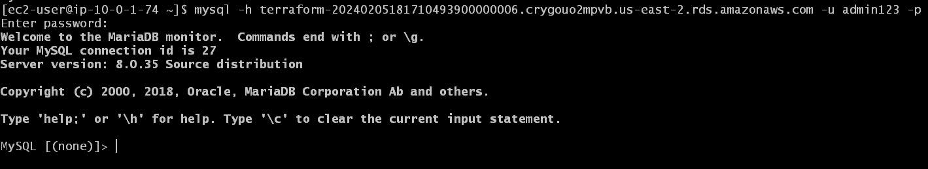
CREATED RESOURCES IN AWS
TARGET GROUP
AUTO SCALING GROUP
RDS
ACCESSING RDS

Slide 24
LINKS & RESOURCES
Terraform Installation Link
https://developer.hashicorp.com/terraform/install
Here is the Link of my GitHub Repository which contains all the Terraform Configuration files that used to create this Infrastructure.
https://github.com/mujahidshaik28/terraform-project.git

Slide 25


THANK YOU
ANY QUERIES ?

